Slide 1

PRESENTATION TITLE
Information presentation
1/29/2023

Slide 2

TEXT LAYOUT 1
Agenda
Data Science Lifecycle​
Project Overview​
Data
Analysis
Modeling
Model Evaluation
Recommendations

Slide 3
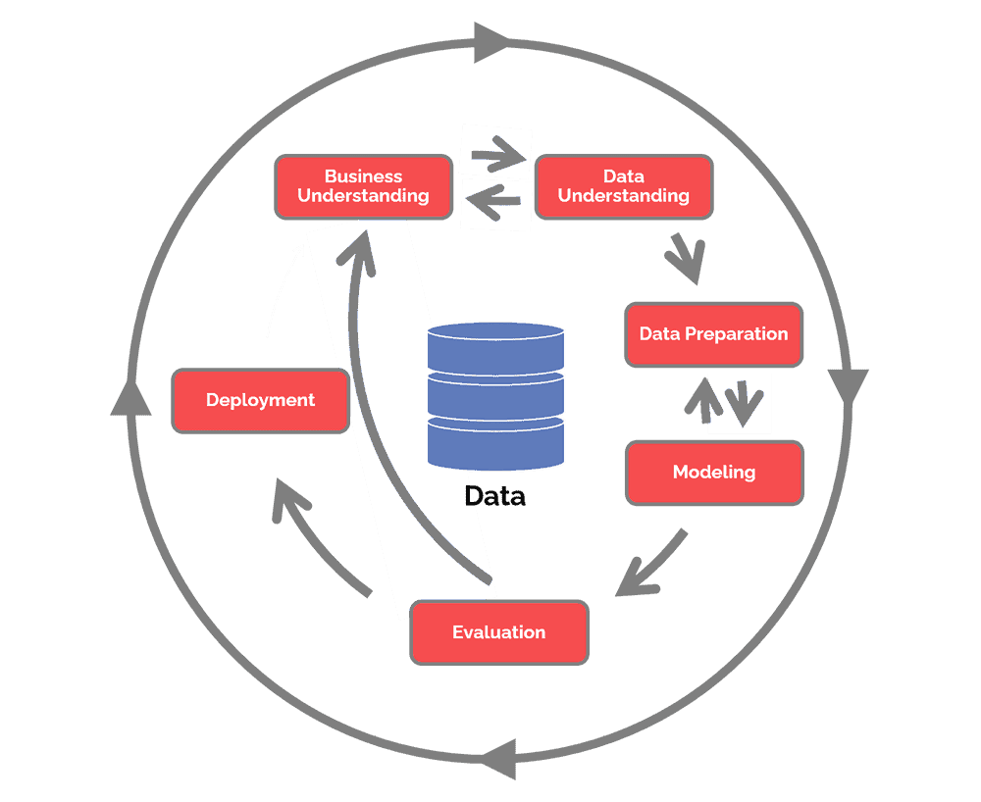
Data Science Lifecycle

Slide 4
TEXT LAYOUT 1
Project Overview
Business Problem: home loan takes too long to process and customers are unaware of the results and nor the bank knows of the customer is a good borrower
Business Objective: predict the customer as a good borrower or not
Hypothesis: Forecast the loan status depending on past information of the customer like gender, income, marriage…

Slide 5
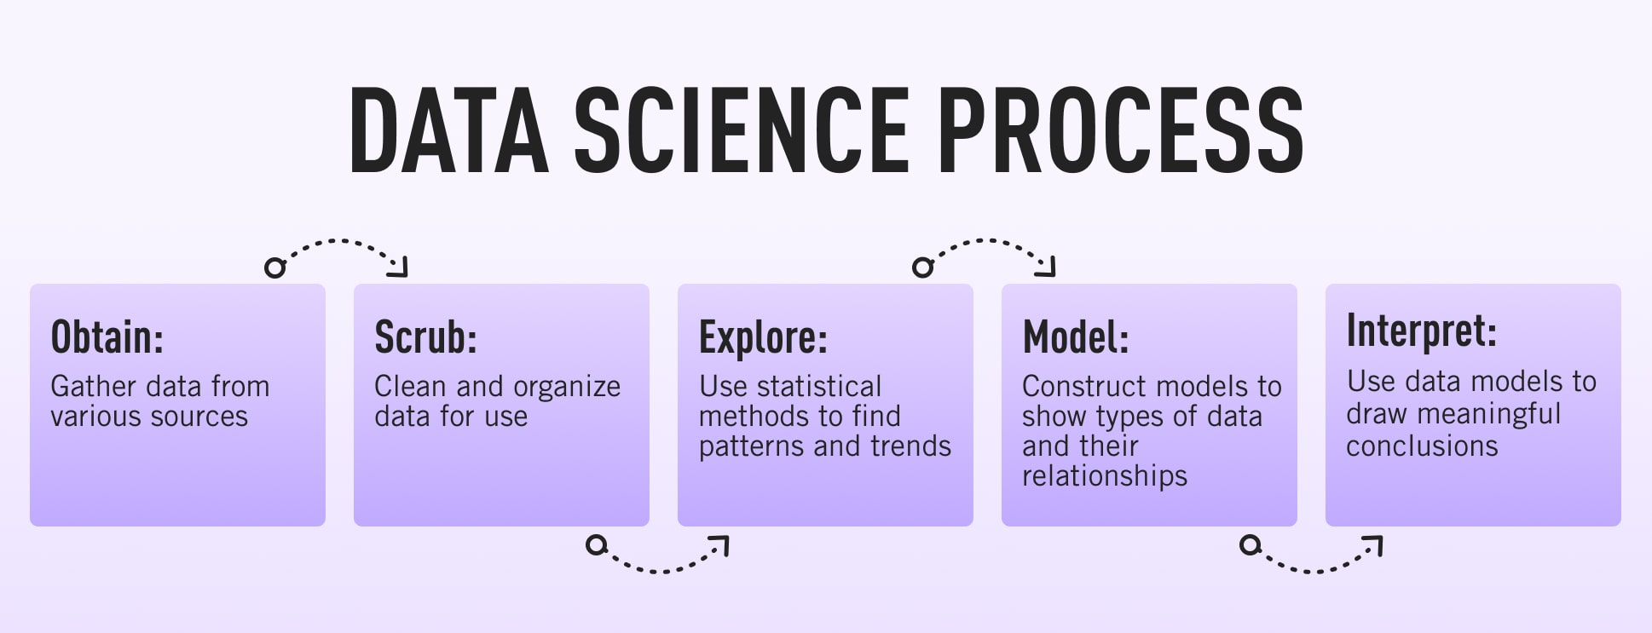
Process Overview / Solution

Slide 6
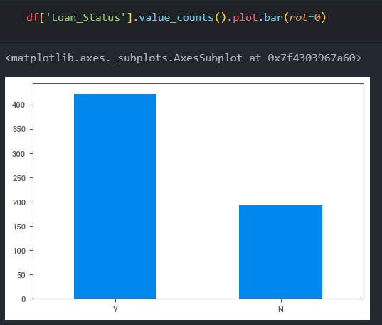
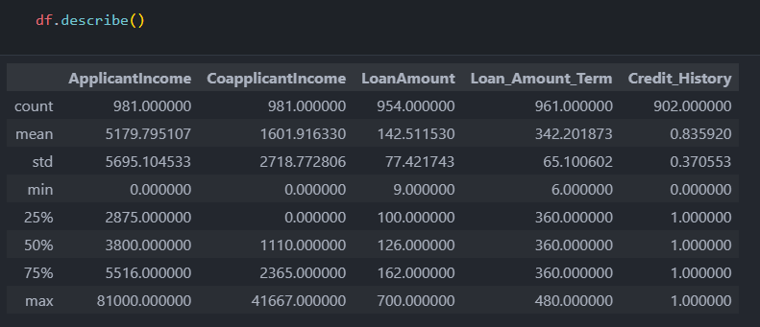
Data

Slide 7
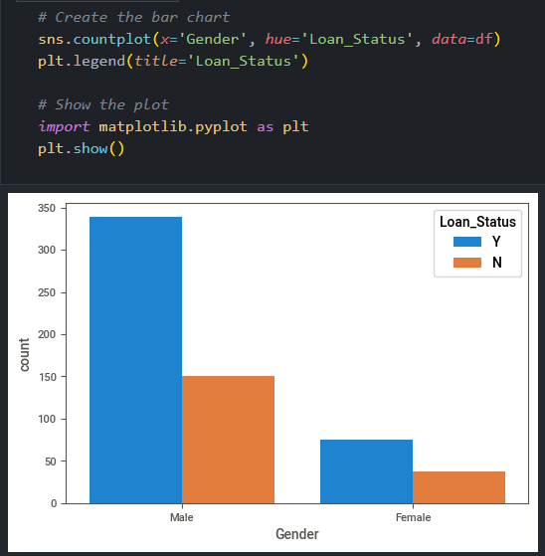
TEXT LAYOUT 1
Analysis
Insert Analysis

Slide 8
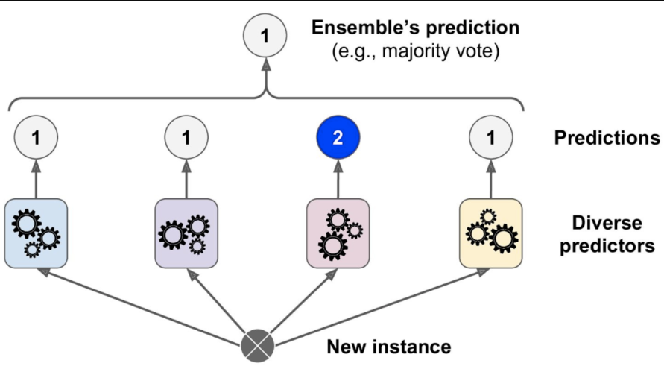
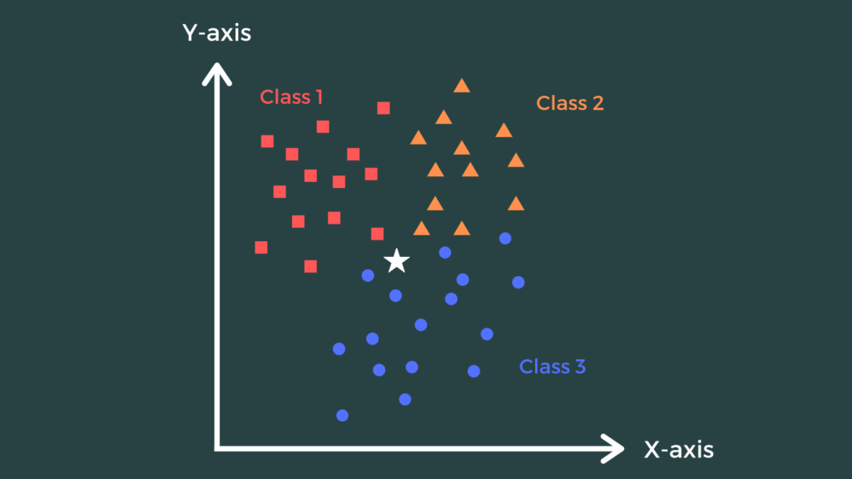

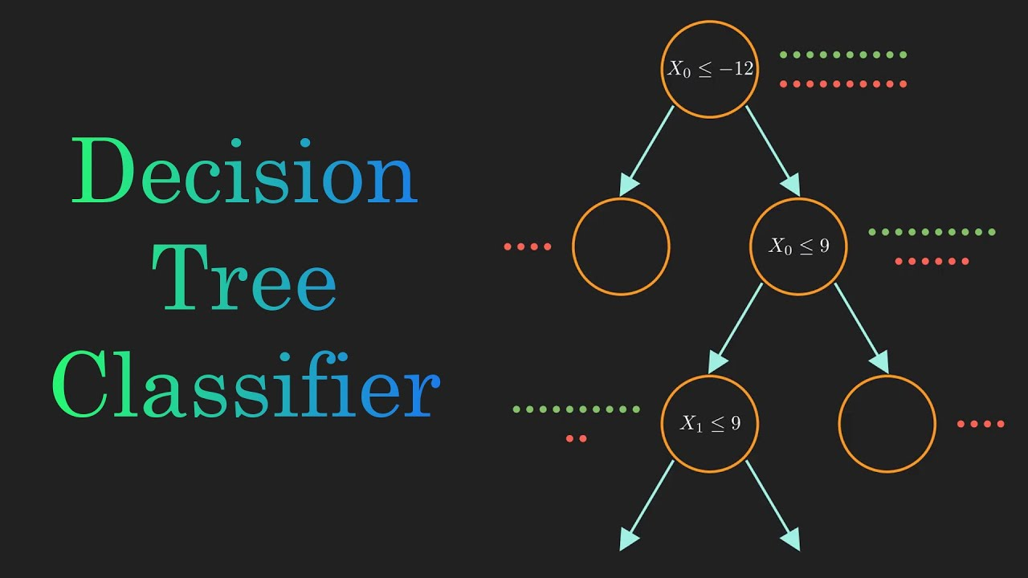
Model: Ensemble Learning

Slide 9

TEXT LAYOUT 1
Model Evaluation
Auto ML : 0.78
Custom ML model: 0.78

Slide 10
TEXT LAYOUT 1
Recommendations
Both performed well on the dataset
AutoML is easier to use and can be more beneficial for the real time
AutoML will probably be a better solution

